Slide 1


THANG HUYNH VINH (JOHN)
12 FEB 2023

Slide 2

Outline
Executive Summary
Introduction
Methodology
Results
Conclusion
Appendix

Slide 3
Executive Summary
Summary of methodologies
Data Collection, from public SpaceX API and SpaceX Wikipedia page.
Data wrangling, including adding an indicator for successful landings.
EDA, via SQL queries and various visualizations and data summaries.
Explored and analyzed further, using Folium to generate interactive maps.
Interactive dashboard developed with Plotly Dash.
Machine learning models trained to predict successful landings through classification techniques.
Summary of all results
The resulting models all produced similar results, with an accuracy rate of ~83.33% when tested with a test data set. The models tended to over predict successful landings. Training the model with more data could lead to improved accuracy.

Slide 4
Introduction
Project background and context:
The project goal to evaluate the saving cost for SpaceY, which part can be reused in order to compete with SpaceX.
Problems you want to find answer:
Which factor (feature) impact the successfully landing?
Which place will be the best for launching?

Slide 5

Section 1

Slide 6
Methodology
Executive Summary
Data collection methodology:
There are 2 sources: SpaceX REST API and Web scraping from Spacex Wikipedia.
Perform data wrangling
Irrelevant field removed, replace Null values.
Encoding Labeled data to resolve Classification Model.
Perform exploratory data analysis (EDA) using visualization and SQL

Slide 7
Methodology
Executive Summary
Perform interactive visual analytics using Folium and Plotly Dash
Perform predictive analysis using classification models
Preprocess data which convert relevant features into Labeled value.
Devide data into Train and Test.
Perform prediction on 4 models: Logistic, SVC, Decision Tree and KNN.

Slide 8
Data Collection
Dataset was collected in 2 ways:
SPACEX REST API: api.spacexdata.com/v4/.
Web Scraping: https://en.wikipedia.org/wiki/List_of_Falcon/_9/_and_Falcon_Heavy_launches

Slide 9
Data Collection – SpaceX API
Use public API in a form of .json then convert to .csv dataset.
Github url
Request SpaceX API
Filter Data only inclued Falcon 9
Missing value replaced

Slide 10
Data Collection - Scraping
Get Falcon 9 data from Wikipedia url.
Github link
Request Wiki url
Get data from HTML Table on the url
Create the dataframe by parsing te html table.

Slide 11
Data Wrangling
EDA
Summarization
Create Landing outcome label
Exploratory Data Analysis (EDA) performed on the dataset.
Summarize the result of each orbit and occurrence of mission outcomes.
Create outcome label from Outcome column.
Github url

Slide 12
EDA with Data Visualization
To explore data, scatterplots and barplots were used to visualize the relationship between pair of features:
Scatter plot: Payload Mass X Flight Number, Launch Site X Flight Number, Launch Site X Payload Mass, Orbit and Flight Number, Payload and Orbit
Bar plot: Mean x Orbit.
Line plot: Success rate x Year
Github url

Slide 13
EDA with SQL
Using bullet point format, summarize the SQL queries you performed
Display the names of the unique launch sites in the space mission
Display 5 records where launch sites begin with the string 'CCA'
Display the total payload mass carried by boosters launched by NASA (CRS)
Display average payload mass carried by booster version F9 v1.1
List the date when the first succesful landing outcome in ground pad was acheived.
List the names of the boosters which have success in drone ship and have payload mass greater than 4000 but less than 6000
List the total number of successful and failure mission outcomes

Slide 14
EDA with SQL
Using bullet point format, summarize the SQL queries you performed
List the names of the booster_versions which have carried the maximum payload mass. Use a subquery
List the records which will display the month names, failure landing_outcomes in drone ship ,booster versions, launch_site for the months in year 2015.
Rank the count of successful landing_outcomes between the date 04-06-2010 and 20-03-2017 in descending order.
Github url

Slide 15
Build an Interactive Map with Folium
Markers, circles, lines and marker clusters were used with Folium Maps
Markers indicate points like launch sites
Circles indicate highlighted areas around specific coordinates, like NASA Johnson Space Center
Marker clusters indicates groups of events in each coordinate, like launches in a launch site
Lines are used to indicate distances between two coordinates.
Github url

Slide 16
Build a Dashboard with Plotly Dash
The following graphs and plots were used to visualize data
Percentage of launches by site
Payload range
This combination allowed to quickly analyze the relation between payloads and launch sites, helping to identify where is best place to launch according to payloads.
Github url

Slide 17
Predictive Analysis (Classification)
Train & test on 4 models: Logistic, SVC, Decision Tree, KNN
Compare Scores to find the best models.
Github url

Slide 18
Results
Exploratory data analysis results
Interactive analytics demo in screenshots
Predictive analysis results

Slide 19

Section 2

Slide 20
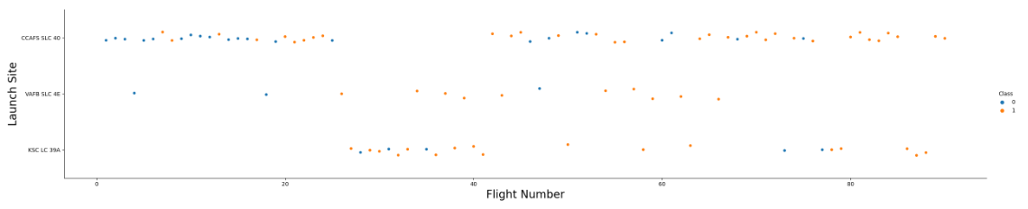
Flight Number vs. Launch Site
Show a scatter plot of Flight Number vs. Launch Site
Orange indicates Successful launch while Blue as Unsuccessful launch.
The unsuccessful launch happened frequent in the early launch, success rate increased for more recent flight.

Slide 21
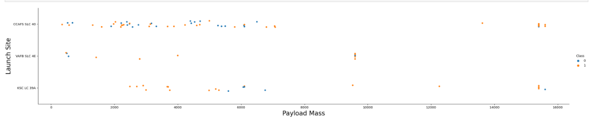
Payload vs. Launch Site
The unsuccessful launch (blue) happen frequently if Pay load Mass less than 7000 (Kg).
Payload Mass over than 8000 seem to be possible for CAFS SLC 40 & KSC LC 39A Launch sites.

Slide 22
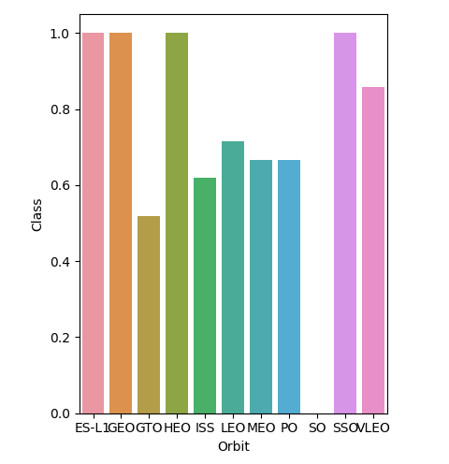
Success Rate vs. Orbit Type
Top Success rate:
ES-L1, GEO, HEO & SSO (100%).
VLEO (above 80%).
LFO (above 70%).

Slide 23
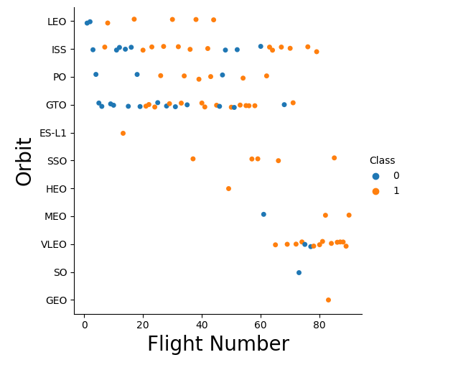
Flight Number vs. Orbit Type
For LEO Orbit, the success rate related to the number of flight.
On the other hand, there is no relationship between Flight number and GTO orbit.

Slide 24
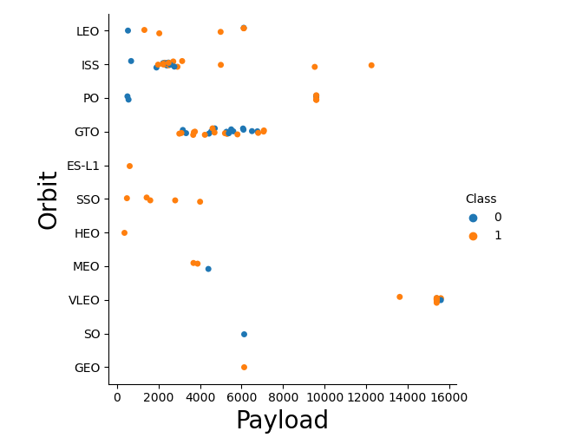
Payload vs. Orbit Type
The more heavy Payload, the more positive landing for PO, LEO & ISS.
For GTO, it’s hard to know because the positive and negative landing rate appear randomly.

Slide 25
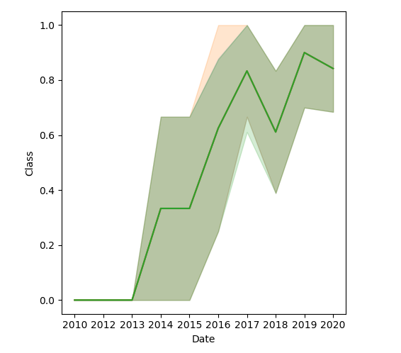
Launch Success Yearly Trend
The success rate increase enormously from 2013 till 2020.

Slide 26
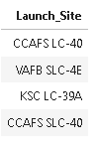
All Launch Site Names
Use Distinct function to find the unique value.
“%%sql
SELECT DISTINCT Launch_Site
FROM SPACEXTBL”

Slide 27
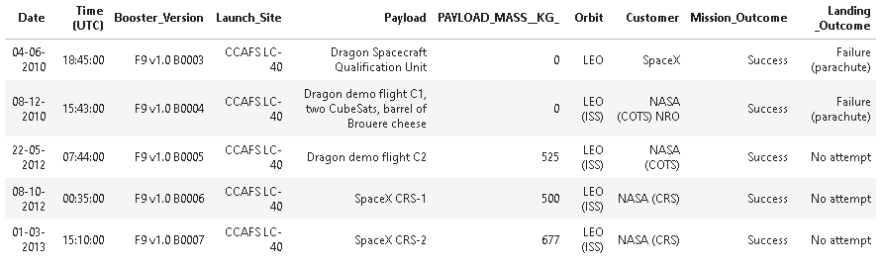
Launch Site Names Begin with 'CCA'
Use Like to find value with “CCA” and Limit 5 will display 5 rows
%%sql
SELECT *
FROM SPACEXTBL
WHERE LAUNCH_SITE LIKE 'CCA%'
LIMIT 5

Slide 28
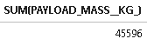
Total Payload Mass
Total payload carried by boosters from NASA
%%sql
SELECT SUM(PAYLOAD_MASS__KG_)
FROM SPACEXTBL
WHERE CUSTOMER = 'NASA (CRS)’

Slide 29
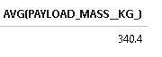
Average Payload Mass by F9 v1.1
The average payload mass carried by booster version F9 v1.1
%%sql
SELECT AVG(PAYLOAD_MASS__KG_)
FROM SPACEXTBL
WHERE Booster_Version LIKE 'F9 v1.0%'

Slide 30

First Successful Ground Landing Date
The first successful landing outcome on ground pad
%sql SELECT MIN(DATE)
FROM SPACEXTBL
WHERE "Landing _Outcome" = "Success (ground pad)"

Slide 31
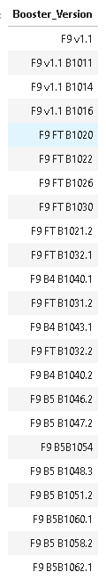
Successful Drone Ship Landing with Payload between 4000 and 6000
List the names of boosters which have successfully landed on drone ship and had payload mass greater than 4000 but less than 6000
%%sql
SELECT DISTINCT BOOSTER_VERSION
FROM SPACEXTBL
WHERE PAYLOAD_MASS__KG_ > 4000
AND PAYLOAD_MASS__KG_ < 6000

Slide 32
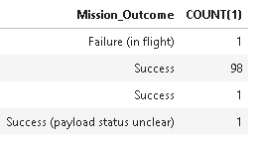
Total Number of Successful and Failure Mission Outcomes
The total number of successful and failure mission outcomes
%%sql
SELECT Mission_Outcome, COUNT(1)
FROM SPACEXTBL
GROUP BY Mission_Outcome

Slide 33
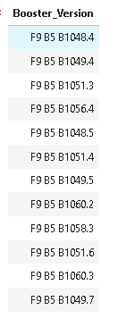
Boosters Carried Maximum Payload
List the names of the booster which have carried the maximum payload mass
%%sql
SELECT DISTINCT Booster_Version FROM SPACEXTBL
WHERE PAYLOAD_MASS__KG_ =
(SELECT MAX(PAYLOAD_MASS__KG_) FROM SPACEXTBL)

Slide 34
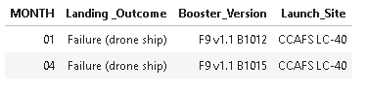
2015 Launch Records
List the failed landing_outcomes in drone ship, their booster versions, and launch site names for in year 2015
%%sql
SELECT substr(Date, 4, 2) MONTH, "Landing _Outcome", Booster_Version, Launch_Site
FROM SPACEXTBL
WHERE substr(Date, 7, 4) = '2015'
AND "Landing _Outcome" = 'Failure (drone ship)'

Slide 35
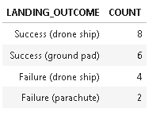
Rank Landing Outcomes Between 2010-06-04 and 2017-03-20
Rank the count of landing outcomes (such as Failure (drone ship) or Success (ground pad)) between the date 2010-06-04 and 2017-03-20, in descending order
%%sql
SELECT TRIM("Landing _Outcome") LANDING_OUTCOME
, COUNT(1) COUNT
FROM SPACEXTBL
WHERE Date BETWEEN '04-06-2010' AND '20-03-2017'
AND ("Landing _Outcome" LIKE 'Success (%' OR "Landing _Outcome" LIKE 'Failure (%')
GROUP BY "Landing _Outcome"
ORDER BY count Desc

Slide 36

Section 3

Slide 37
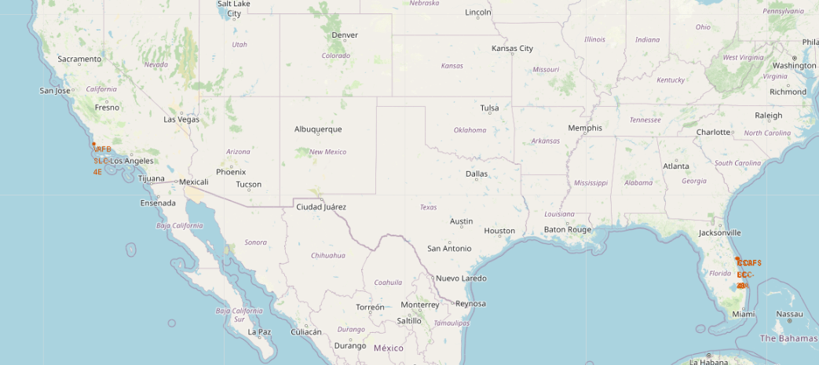
<Folium Map Screenshot 1>
Launch Site always neer the sea, with sparsely populated, not too far from big roads & railroads.

Slide 38
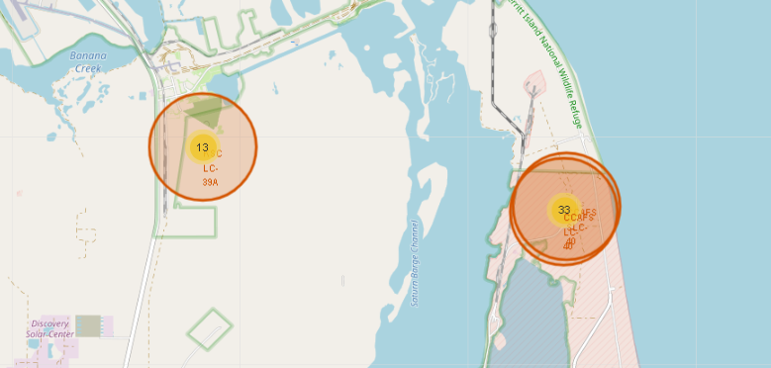
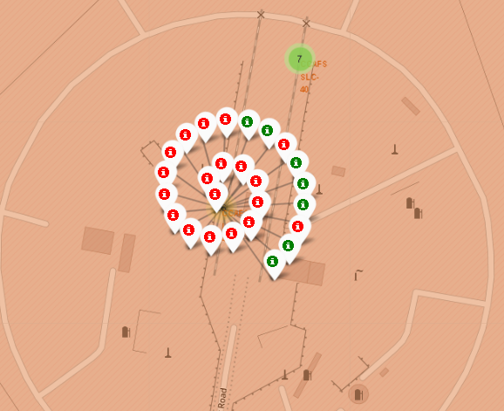
<Folium Map Screenshot 2>
Green marker display successful landing, while red are faiure.

Slide 39
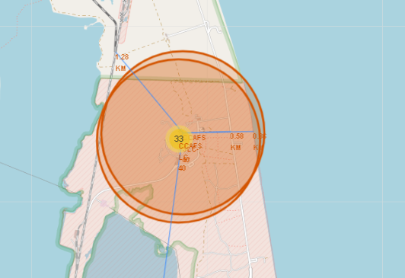
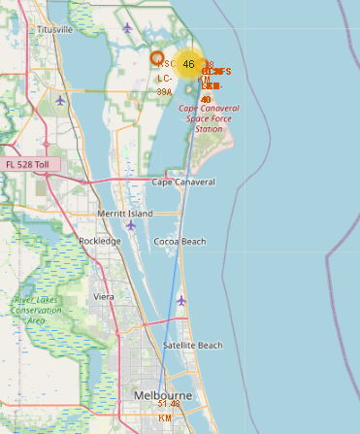
<Folium Map Screenshot 3>
Example of CAFFS SLC-40 Launch Sites

Slide 40

Section 4

Slide 41
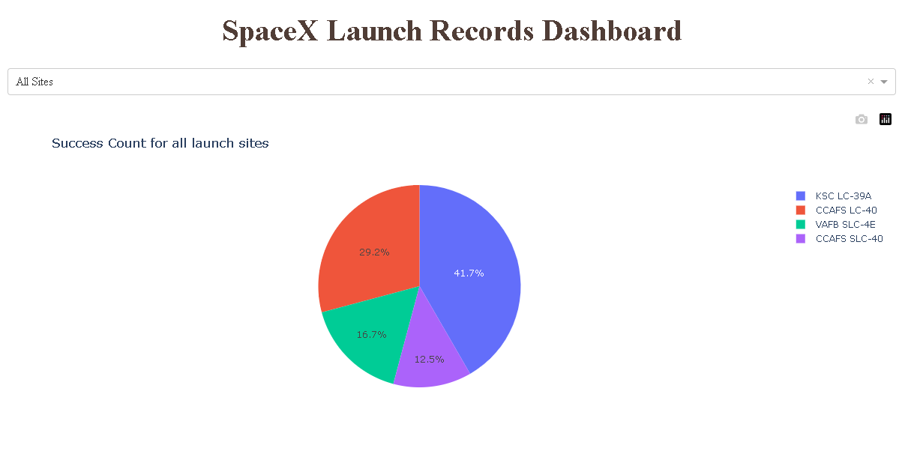
<Dashboard Screenshot 1>
Lauching location seem impact to the success launch.
Top Location:
KSC LC 39A
CCAFS LC-40

Slide 42
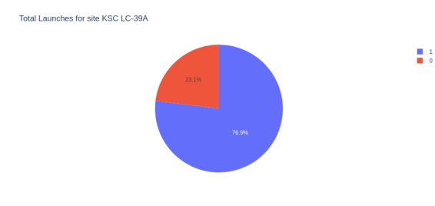
<Dashboard Screenshot 2>
Top launch site have successful rate 76.9%

Slide 43
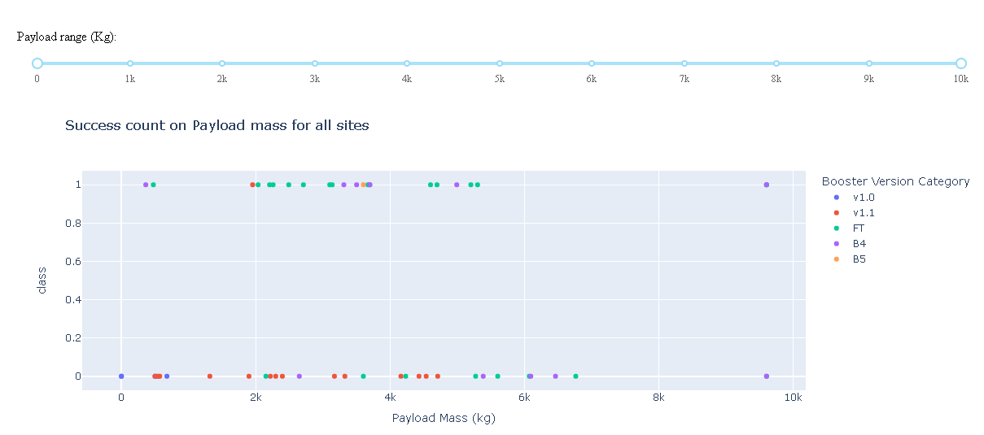
<Dashboard Screenshot 3>
All booster have both success and failure, v1.1 has many failure than others.

Slide 44

Section 5

Slide 45
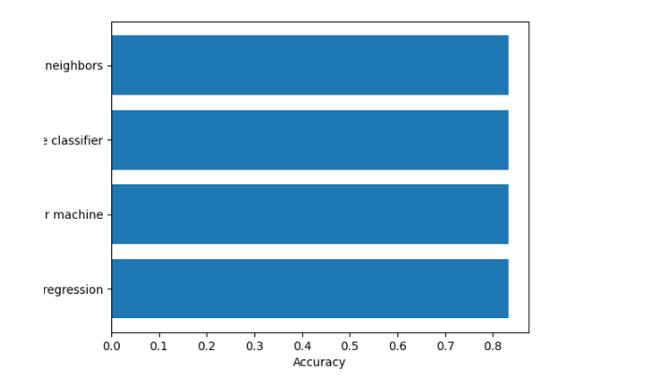
Classification Accuracy
All model generate 83.33% accuracy.
Tree classifier have unstable accuracy when using GridSearchCv, the result usually ~ 73%.

Slide 46
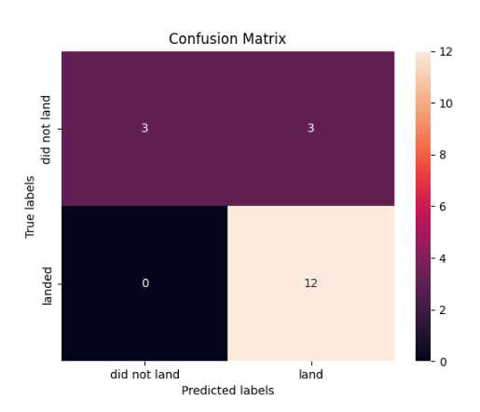
Confusion Matrix
With the result of 83.33% accuracy, the models give the same Confusion Matrix.

Slide 47
Conclusions
The machine learning model give the same result with 83.33% accuracy due to the small amount of data. If trained on a bigger samples, we may find the best models.
The Successful rate was impacted by:
Orbit: LEO, SSO prove its stable.
Location: In folium map, KSC LC – 39A is the best launch site.
Pay Load Mass (Kg): Above 7000 Kg give positive result.

Slide 48
Appendix
Github repository
Note: Folium Jupyter notebook does not show map, so I take a picture.
Special thank to IBM Team.

Slide 49


